Slide 1
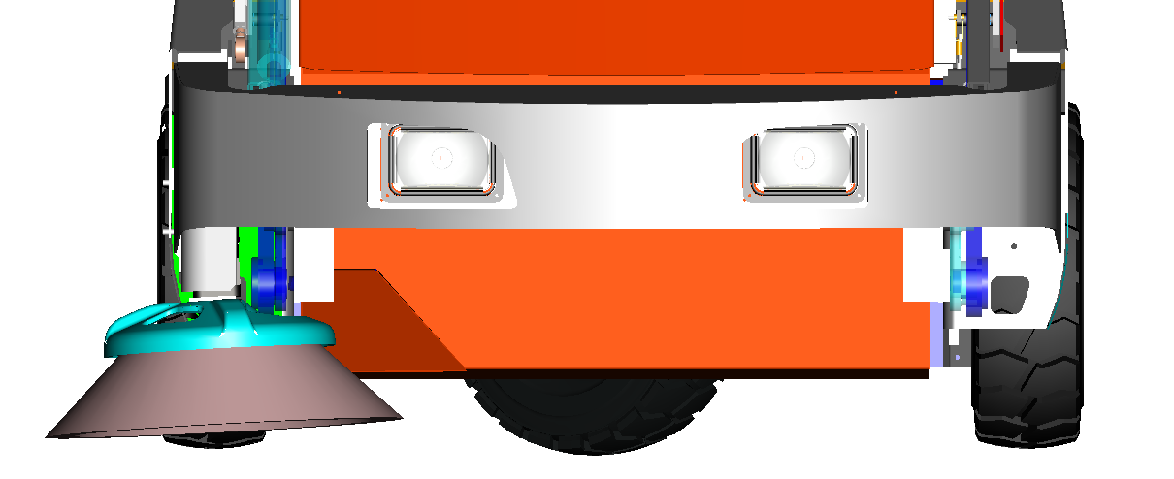
Dust Suppression System Nozzles
SPRAY DIRECTION
INSTALLED NOZZLE
MIST AREA
BROOM ROTATION
BROOM MOUNT
Current Spray Nozzle: 1/8JBC+SU2
Our current spray nozzles spray in a cone spray and sprays the ground infront and creates the mist as it hits the ground.
We would like a setup where the mist is located right below the bumper but does not (or minimally) wets the floor itself, like a cloud/fog.

